Slide 1
EDGD801
Learning and behaviour
Behaviour management strategies
Lecture 9
Humanist approaches
May 19
Presented by Ray Handley

Slide 2
This week
Humanist approaches:
Carl Rogers
Haim Ginott
Thomas Gordon

Slide 3
HUMANIST
approaches to behaviour management
The principles underlying the humanist approach focus on . . . .
the inner thoughts,
feelings,
psychological needs,
and emotions of the individual learner.

Slide 4
HUMANIST
approaches to behaviour management
Humanist approaches emphasise allowing the student time to develop control over his or her behaviour rather than insisting on immediate behavioural change or compliance.
They use interventions that stress . . .
the use of communication skills,
an understanding of student motives,
private conferences,
individual and group problem solving,
and the exercise of referent and expert power.

Slide 5
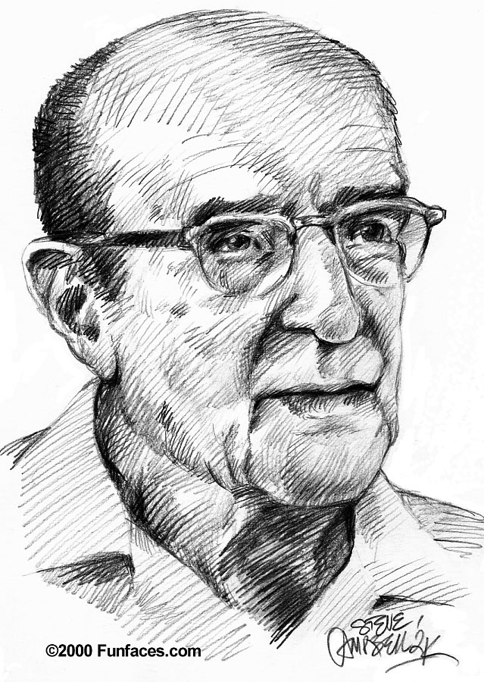
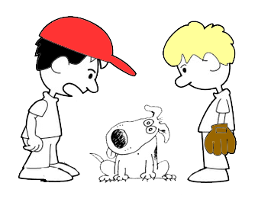
Carl Rogers
(1902 - 1987)
Student-centred education
from Barrett-Lennard, G. T. (1998) Carl Roger's Helping System. Journey and substance Sage, London
We cannot teach another person directly; we can only facilitate his learning.
Two boys talking. One says to the other “I have taught my dog to talk.”
The other boy replies, “But your dog can’t talk.”
The first boy nods and adds, “I know, I said I taught him not that he learnt how to do it.”
The structure and organisation of the self appears to become more rigid under threat, and to relax its boundaries when completely free from threat.

Slide 6
Carl Rogers
(1902 - 1987)
Student-centred education
from Barrett-Lennard, G. T. (1998) Carl Roger's Helping System. Journey and substance Sage, London
The educational situation which most effectively promotes significant learning is one in which:
the threat to the learner’s self is reduced to a minimum, and
a differentiated perception of the field of experience is facilitated.
students learn ways to look at experiences and situations differently.

Slide 7
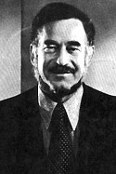
HAIM GINOTT
Famous quote from
I have come to the frightening conclusion that I am the decisive element in the classroom.
It is my personal approach that creates the climate. It is my daily mood that makes the weather. As a teacher, I possess a tremendous power to make a child's life miserable or joyous.
Ginott, H. (1995). Teacher and child. Collier, N.Y.
I can be a tool of torture or an instrument of inspiration. I can humiliate or humour, hurt or heal. In all situations, it is my response that decides whether a crisis will be escalated or de-escalated, a child humanised or de-humanised.

Slide 8
HAIM GINOTT
(1922 - 1973)
Ginott likened a newly graduated teacher to a man who has a thousand-dollar bill, but doesn't have small change to buy a cup of coffee.
One of his rather startling observations was that children are our enemies and we don't know it, and we are their friends and they don't know it.
When things go wrong, it’s not a good time to teach lessons (“When someone is drowning it’s not a good time to teach them to swim”)

Slide 9
HAIM GINOTT
Strict or Permissive
from http://www.betweenparentandchild.com/index.php?s=content&p=free_parenting_video_clips

Slide 10
HAIM GINOTT
from http://www.betweenparentandchild.com/index.php?s=content&p=free_parenting_video_clips

Slide 11
HAIM GINOTT
Ginott’s contribution to classroom discipline:
provided the first coherent strategies for
building classroom discipline through communication
clarified his contentions by describing teachers at their best and teachers at their worst
explained the nature of congruent communication and detailed the techniques for its use
showed how effective discipline is gained through small, gentle steps rather than strong tactics
explained how teachers can show genuine emotion without hurting relations with students
Source: Lynn R. Zubov from the website of the Winston Salem State University
http://gorams.wssu.edu/faculty/zubovl/

Slide 12
Congruent Communication
Key Features
address situations rather than character
invites cooperation
accepts and acknowledges feelings
expresses anger appropriately
uses brevity in correcting misbehaviour
uses appreciative rather than evaluative praise
Source: Lynn R. Zubov from the website of the Winston Salem State University
http://gorams.wssu.edu/faculty/zubovl/

Slide 13
Non-congruent Communication
Key Features
labels students and name-calls
asks rhetorical “whys” and gives moralistic lectures
invades students’ privacy
makes caustic or sarcastic remarks to students
attacks students’ character
demands rather than invites cooperation
denies students’ feelings
shows loss of temper
uses evaluative praise to manipulate students
Source: Lynn R. Zubov from the website of the Winston Salem State University
http://gorams.wssu.edu/faculty/zubovl/

Slide 14
Key Features
Main teachings
Never deny a child's feelings. Only behaviour is unacceptable.
Take the personal out of interactions. This means state the problem. "I see muddy boots on the floor" rather than belittling the child who left them. Rules should be attached to things, e.g., "This couch is not for jumping."
Dependence breeds hostility. Never do for a child what he is capable of doing for him or herself.
Source: Morton, U. from http://www.kingsleyschool.ca/who_was_haim_ginott.htm

Slide 15
Key Features
Main teachings
Children need the security of limits. Think of a firm floor and ceiling, within which children have autonomy and choices. "Would you like a full or half glass of milk?"
Avoid words like never, always, e.g. "You never listen to me," "Why do you always...", etc.
Source: Morton, U. from http://www.kingsleyschool.ca/who_was_haim_ginott.htm

Slide 16
Ginott’s
Special Techniques
to correct student misbehavior use laconic language and show students how to behave
to express anger do so genuinely, but with no sarcasm or hostility
to praise students show appreciation for what students DO, not what they are
to invite cooperation indicate what needs to be done, without bossing
to use their hidden asset – ask . . . “How can I be helpful to my students right now?”
Source: Lynn R. Zubov from the website of the Winston Salem State University
http://gorams.wssu.edu/faculty/zubovl/

Slide 17
Evaluative praise
Appreciative or descriptive praise
That’s a beautiful picture.
You are strong.
You’re a great cook.
Great job
That's fantastic!
I like the details you used in your picture. The colours you chose are so lifelike.
That was a heavy load. Thank you for helping me carry it.
The flavours in your salad were so crisp and fresh.
You’re using your inside voice. Thank you.
I appreciate that you didn’t interrupt while I was giving my maths lesson.
Thank you for not arguing.
Thank you for cleaning up when you were asked.
from
Michelle Irinyi (2007) Montessori Classroom – Descriptive vs. Evaluative Praise website http://montessoritraining.blogspot.com/2007/06/montessori-classroom-descriptive-vs.html

Slide 18
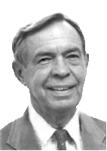
Thomas Gordon
(1918 - 2002)
TEACHER EFFECTIVENESS TRAINING
Use power, lose influence
More crimes have been committed against humanity in the name of obedience than in the name of rebellion

Slide 19
ROADBLOCKS TO COMMUNICATI N
Thomas Gordon
Some typical responses that communicate unacceptance are:
1. Ordering, commanding, directing.
Example: "Stop whining and get back to work."
2. Warning, threatening.
Example: "You had better get your act together if you expect to pass my class."
3. Moralising, preaching, giving "shoulds" and "oughts".
Example: "You should leave your personal problems out of the classroom."
4. Advising, offering solutions or suggestions.
Example: "I think you need to get a daily planner so you can organise your time better to get your homework finished."
5. Teaching, lecturing, giving logical arguments.
Example: "You better remember you only have four days to complete that project."

Slide 20
ROADBLOCKS TO COMMUNICATI N
Thomas Gordon
These next responses tend to communicate inadequacies and faults:
6. Judging, criticising, disagreeing, blaming.
Example: "You are such a lazy kid. You never do what you say you will."
7. Name-calling, stereotyping, labelling.
Example: "Act your age. You are not a kindergartner."
8. Interpreting, analysing, diagnosing.
Example: "You are avoiding facing this assignment because you missed the directions due to talking."

Slide 21
ROADBLOCKS TO COMMUNICATI N
Thomas Gordon
Other messages try to make the student feel better or deny there is a problem:
9. Praising, agreeing, giving positive evaluations.
Example: "You are a smart kid. You can figure out a way to finish this assignment."
10. Reassuring, sympathising, consoling, supporting.
Example: "I know exactly how you are feeling. If you just begin, it won't seem so bad."

Slide 22
ROADBLOCKS TO COMMUNICATI N
Thomas Gordon
This response tends to try to solve the problem for the student:
11. Questioning, probing, interrogating, cross-examining.
"Why did you wait so long to ask for assistance? What was so hard about this worksheet?"
These messages tend to divert the student or avoid the student altogether:
12. Withdrawing, distracting, being sarcastic, humouring, diverting.
"Seems like you got up on the wrong side of the bed today."

Slide 23
References
Ginott, H. 1972 Teacher and child: a book for teachers and parents. Macmillan, NY.
Gordon, T. 1974 Teacher Effectiveness Training. Wyden, NY
1991 Teaching children self discipline at home and at school. Random House, Sydney
Rogers, C. R. 1951 Client-Centered Counselling Houghton-Mifflin, Boston
Woolfolk, A. 2010 Educational Psychology (2nd Edition) Pearson,
& Margetts, K. Australia (pp 244 – 251)

Slide 24
Creativity, diversity
and the changing needs of education
Ken Robinson

